Slide 1
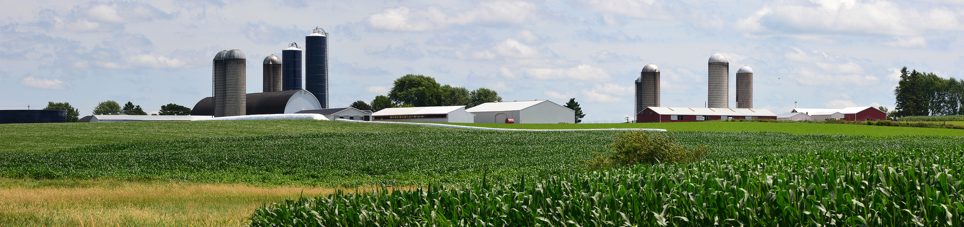
Farmland Preservation Program
Town of Springdale, Dane County 1/7/19

Slide 2
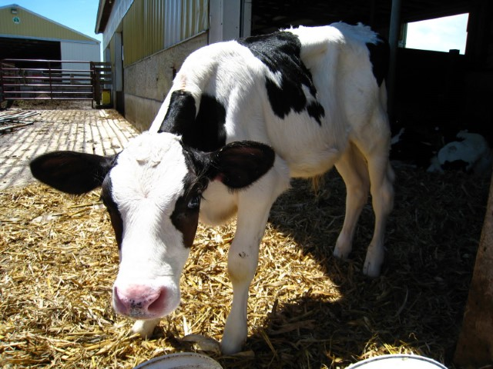
What is the purpose of the farmland preservation program?
To provide tools to local governments and landowners to help limit farmland loss
To provide additional financial incentives to keep land in agricultural use and to meet state soil and water conservation standards

Slide 3
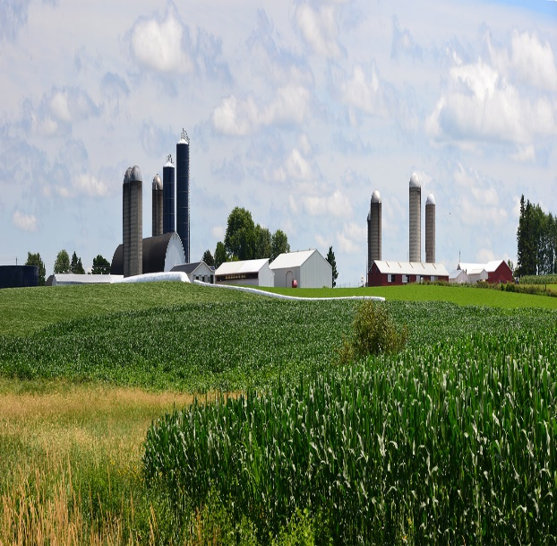
Program Components
Agricultural Enterprise Areas (AEAs)
Farmland Preservation Zoning
Farmland Preservation Agreements
Farmland Preservation Plan
Notes:
Agricultural Enterprise Areas, or AEAs, are a part of the state of Wisconsin’s Farmland Preservation Program. The program consists of farmland preservation planning, which lays the foundation for participating in other aspects of the program, farmland preservation zoning, and AEAs.

Slide 4
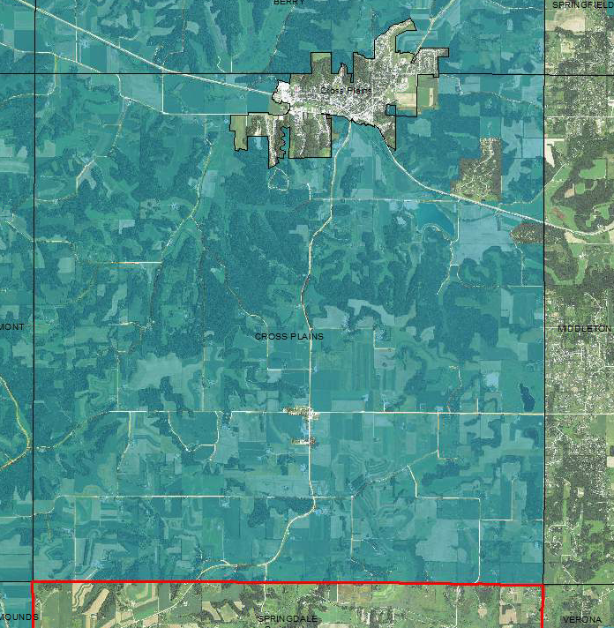
Farmland Preservation Plan
Guides future land use decisions
Identifies land that communities intend to preserve for future agricultural use
Plan area must be based primarily on objective criteria
Enables participation in other aspects of farmland preservation program
Prepared at the County Level with local input

Slide 6
Why would I want my town to be included in the County Farmland Preservation Plan?
Non-binding
Being in a plan area does not apply land use restrictions by itself
Zoning & Farmland Preservation Agreements apply land use restrictions
Property Rights
Not participating in the plan prohibits your neighbors from receiving a tax credit
Soil & Water Quality!
Step towards Tax Credit Eligibility

Slide 7
Farmland Preservation Zoning
Implements FP Plan
Limits allowable uses to agricultural activities and uses compatible to agriculture
At least 80% of land planned for FP should be zoned for FP
Landowners with land located in a farmland preservation zoning district may be eligible to claim a farmland preservation tax credit

Slide 9
What are the allowable uses in an FP Zoning District?
Permitted
Agricultural uses
Accessory uses
Agriculture-related uses
Nonfarm residences constructed in a rural residential cluster (in accordance with CUP issued for cluster under s. 91.46)
Undeveloped natural resource and open space areas
A transportation, utility, communication or other use that is required under state or federal law to be located in a specific place under state or federal law that preempts the requirement of a conditional use permit for that use
Conditional
Agricultural uses
Accessory uses
Agriculture-related uses
Nonfarm residences
Nonfarm residential clusters
Transportation, communications, pipeline, electric, transmission, utility or drainage uses
Governmental, institutional, religious or non profit community uses
Nonmetallic mineral extraction
Oil and gas exploration or production that is licensed by DNR under subch. II of Ch. 295

Slide 10
If my farm is zoned in a Farmland Preservation zoning district, do I have to participate in the program?
No, if you live within a farmland preservation zoning district you do not have to claim the farmland preservation credit
Landowners that do not participate in the program still must follow the land use regulations in the zoning district
If you choose to participate, you must meet applicable soil and water conservation standards
Landowners that participate may be eligible to claim the $7.50/acre income tax credit

Slide 11
Is there a conversion fee for rezoning out of an FP Zoning District?
No!
The rezone conversion fee was removed from statutes in 2011
Local jurisdictions may still issue an administrative fee for a rezone

Slide 12
What are the takeaways for FP Zoning?
Farmland Preservation Zoning Ordinances are locally crafted and administered
They are certified by DATCP to ensure that Ch. 91 standards are met (but they are locally enforced)
FP Zoning can be adopted by a Town, City, Village, ETZ or County
You do not have to claim the farmland preservation credit if you live in a certified district
If you live in a certified district and choose not to claim the credit, you still have to adhere to the use regulations of the district
Landowners that do want to claim the credit need to meet state soil and water conservation standards
Landowners with certified FP Zoning may be eligible to claim the $7.50/acre tax credit
Implement local conservation and farmland protection goals

Slide 13
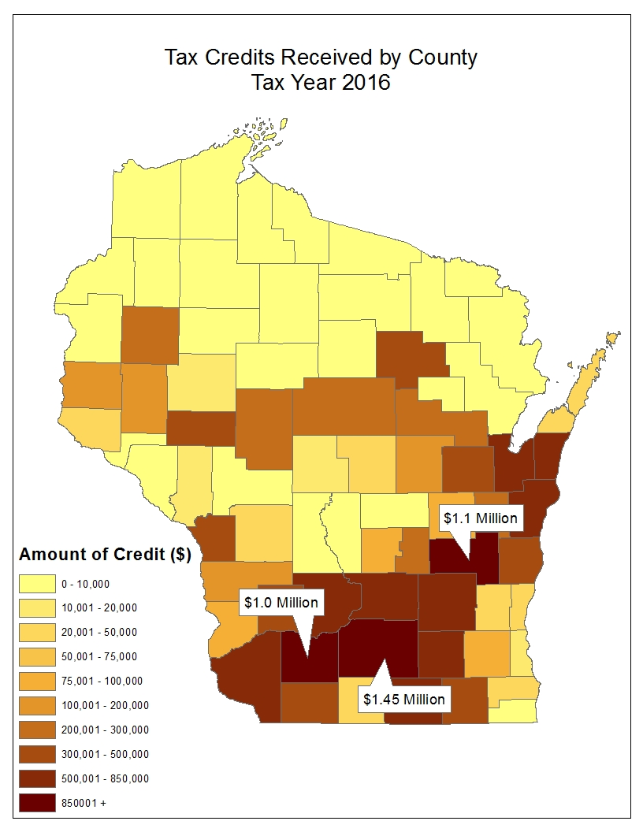
Credits Received
Tax Year 2016
Refundable income tax credit
Flat, per-acre credit ($5, $7.50, or $10 per acre)
No maximum
No acreage minimum
Average claim approximately $1,440 in 2016
Can include managed forest land
Must be in compliance with state soil & water conservation standards

Slide 14
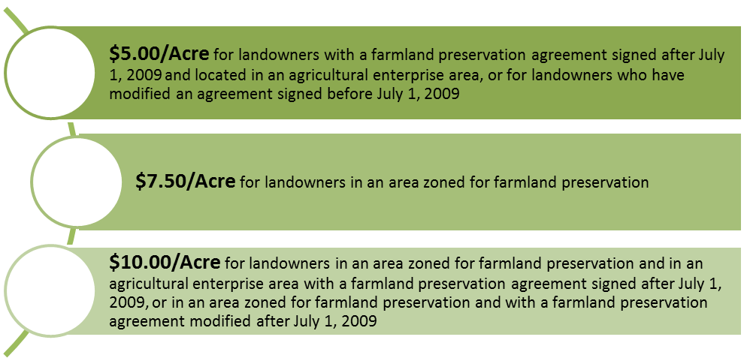
Farmland Preservation Tax Credits

Slide 15
What are the eligibility requirements for claiming the credit?
Claimant must have been the owner of the farmland for the year in which the credit is claimed. The landowner need not be the farm operator and may rent the land to a farmer.
The landowner must have been a resident of Wisconsin for the entire taxable year.
The landowner may not have claimed homestead credit or veterans and surviving spouses’ property tax credit for that year.
The farm must meet applicable state soil and water conservation standards.
The land produced $6,000 in gross farm revenue in the preceding year or $18,000 in gross farm revenue during the preceding three years. If a landowner rents the farmland, the landowner may claim on that land provided the renter meets the gross farm revenue requirement.

Slide 16
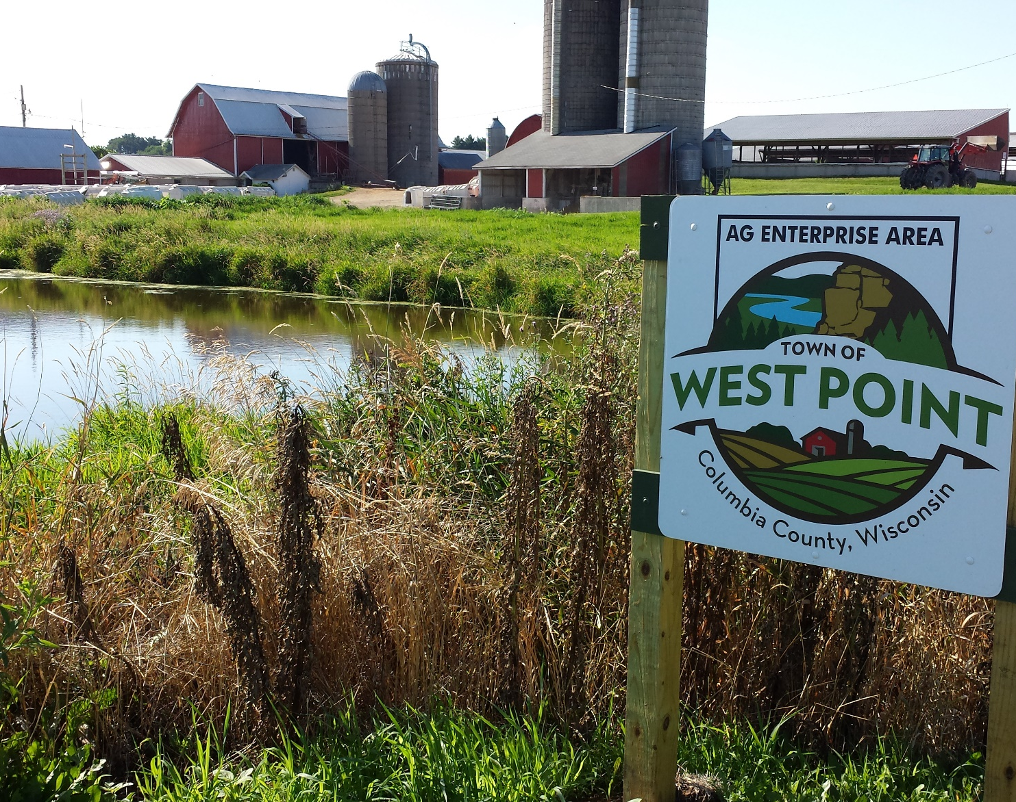
Contact the Farmland Preservation Program for more information
608-224-4621
DATCPWorkingLands@Wisconsin.gov

